Slide 1
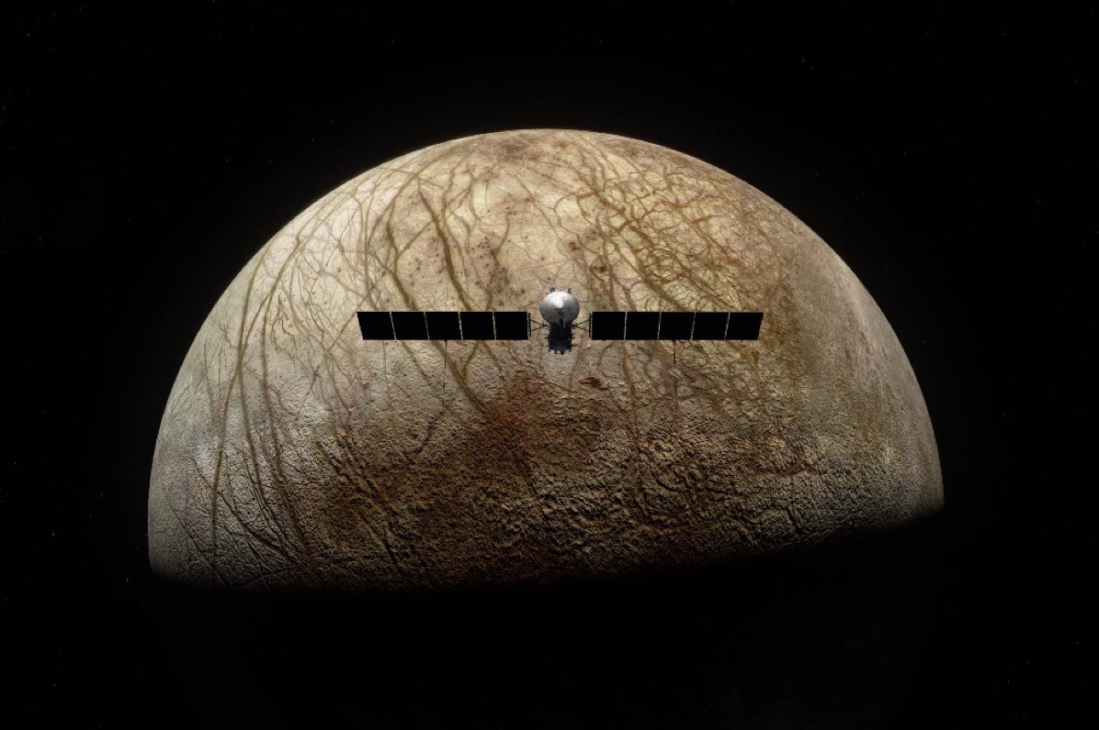
Pilum of Europa
Preliminary Design Review
Michael Frank, Jack Morris, Jakob Schlosser, Thomas Todaro

Slide 2
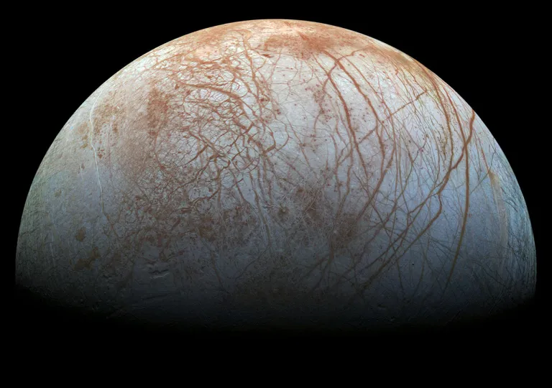
Europa
Europa is the 6th closest moon of Jupiter with an orbital radius of ~671,000 km, period of ~84 hours, and is Jovian-synchronous, meaning, like our moon, the same half of Europa faces Jupiter at all times. Its size is about 90% of our moon's size meaning if gravitational acceleration is only 1.315m/s^2. Its surface is covered in a thick layer, ~15-25 km of ice other than potential water vents that were seen by Hubble to be spewing liquid particulate into the space around it. Europa’s extremely thin, oxygen rich atmosphere and presence of water, even in solid form, open up the possibility of discovering signs of life.

Slide 3
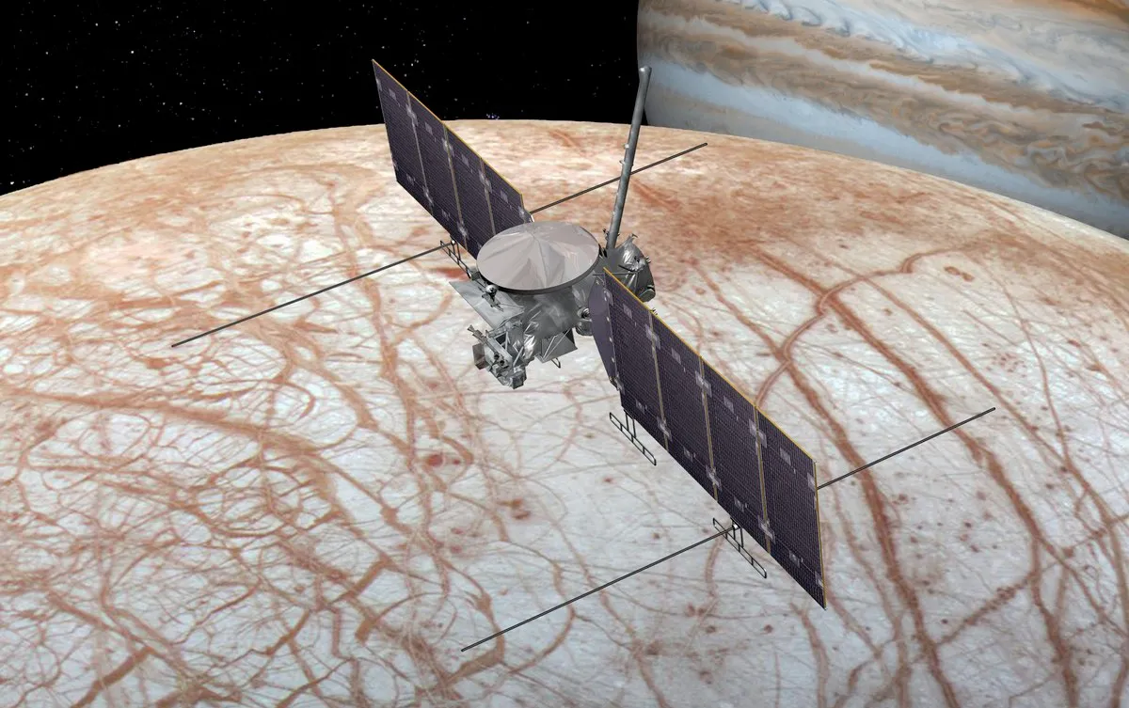
Mission Statement
Our mission would serve as a scientific reconnaissance mission to detect any signs or remnants of life, and also to figure out if there really is an ocean as theorized. If life is determined to have existed then went extinct, we would like to extrapolate potential reasons for the event, such as the radiation emitting from Jupiter. Judging by the salt water and oxygen gas, we suspect organisms similar to primordial algae exist somewhere in the vast oceans of ice. Our mission would consist of a remotely controlled satellite with the objective of sustaining a low altitude, polar orbit of Europa in order to create a detailed scan of its surface topography, determine potential future landing locations, and to drop a surface contacting probe to drill and analyze surface samples, take atmospheric and temperature data, as well as provide footage of the moon. The spacecraft is also planned to try to intercept one of these plumes of water to analyze the content from orbit, much like Cassini did on Saturn’s moon Enceladus.
Upon completion of the previous directives, we would like to use the satellite as a communications relay to transmit the data from the probe back to earth. This mission will continue until sufficient surface data is recovered and the entirety of Europa is scanned and documented by the satellite. Following this we plan to use our leftover propellant to exit the solar system, photographing and transmitting for the remainder of the satellites life until we lose connection.

Slide 4
Objectives
Primary Objectives:
Achieve a stable, low altitude, polar orbit of Europa for communication relays to Earth.
Deploy a probe to the surface of Europa to transmit surface sample and visual data.
Secondary Objectives:
Leave solar system
Photograph passing bodies
Scout areas for future landings/exploration on Europa
Intercept a water plume in orbit and collect samples from it for analysis
Study radiation waves that come from Jupiter

Slide 5
Launch Details

Slide 6
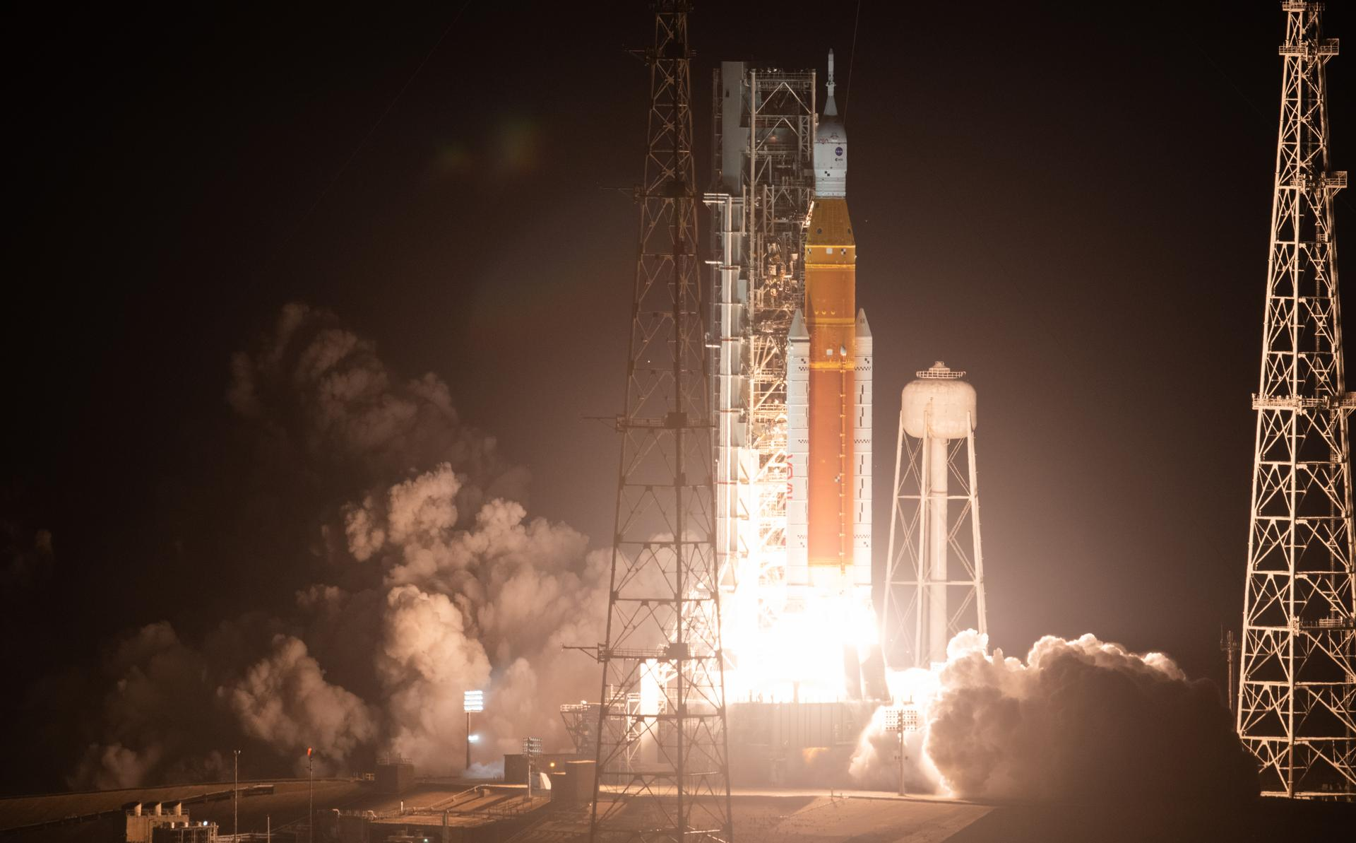
NASA Space Launch System (SLS)
The NASA Space Launch System was designed to take large payloads into deep space and has a maximum launch thrust of 41 MN using block 2 configuration. The launch mass is 2600-2950 metric tons, with the propellant mass about ~50% of that. It can take about 6000 kgs to Jupiter on direct flight.
The SLS vehicle first stage uses 2 strap on solid rocket boosters in the first stage with Polybutadiene acrylonitrile (PBAN) solid propellant, with a specific impulse of 268s, along with a core booster with 4 RS-25D engines with LOX w/ LH2 propellant that has a specific impulse of 451s.

Slide 7
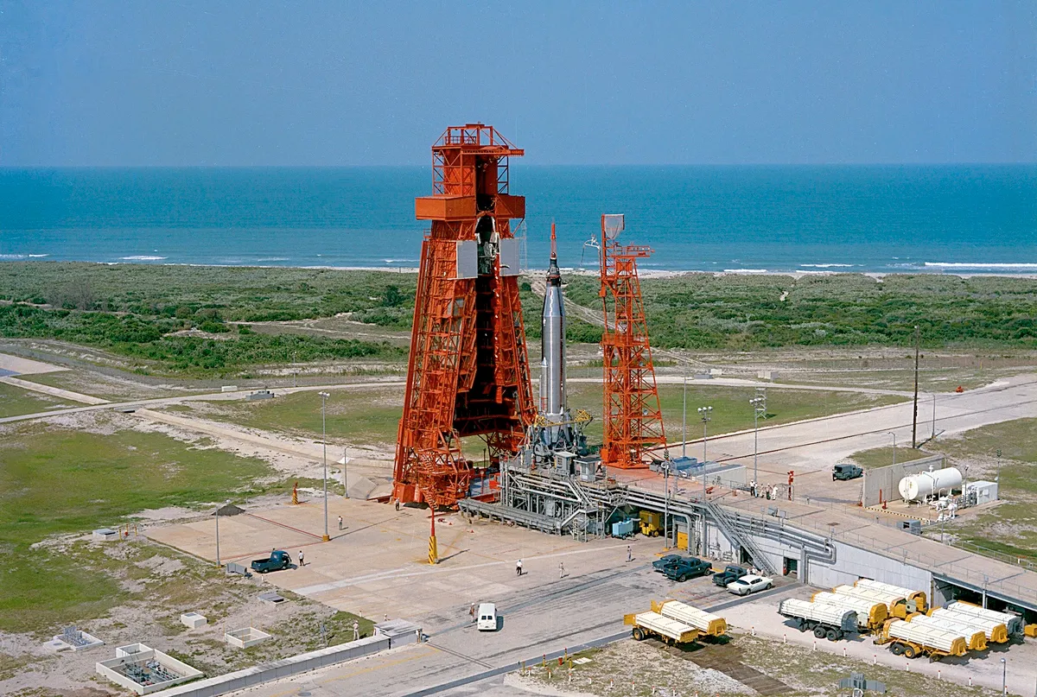
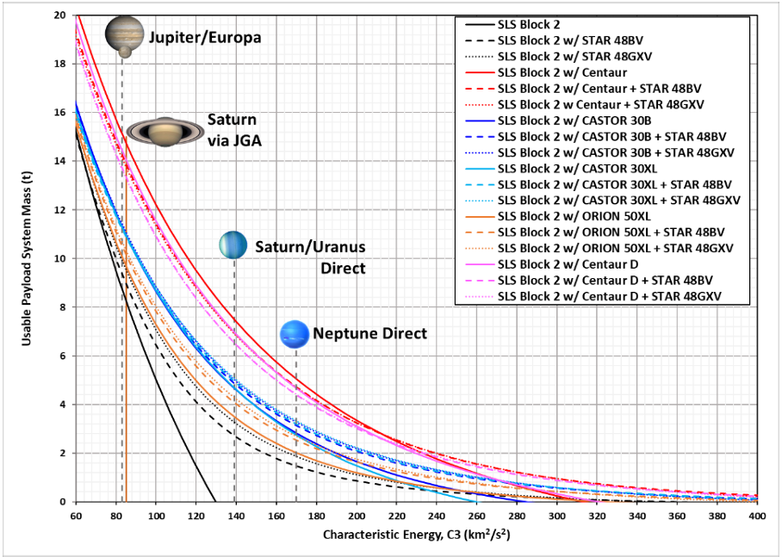
Launch Details
Date: Jan 20 2027
Launch Site: Cape Canaveral
Inclination: 28.5 Degrees
Require C3= 25 km^2/sec^2

Slide 8
Concepts of Operations-
Orbital Mechanics

Slide 9
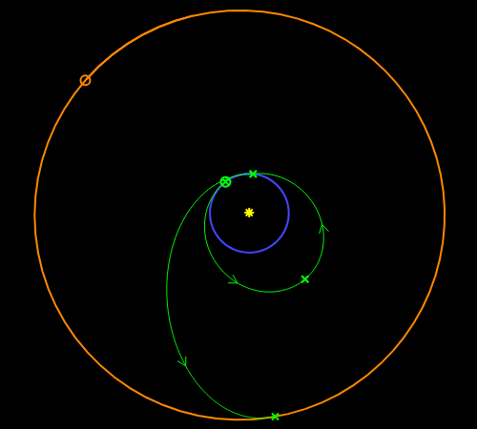
Interplanetary Travel
After launch, Talos will circularize in a 200 km altitude parking orbit around Earth
On Jan 27 2027, Talos will perform a 4.31 km/s maneuver to leave Earth SOI and raise its aphelion to prepare for an Earth gravity assist
On Feb 1 2028, Talos will adjust the previous orbit to intercept Earth’s SOI costing 0.511 km/s
On Dec 15 2028, Talos will perform an Earth flyby costing 0.180 km/s but adding 13.38 km/s
The Lambert transfer will then target Europa directly, catching the moon between Jupiter and the Sun, mid course corrections will cost ~0.222 km/s

Slide 10
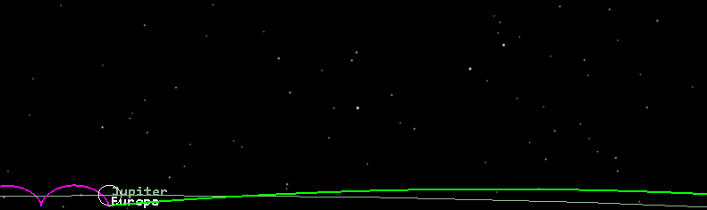
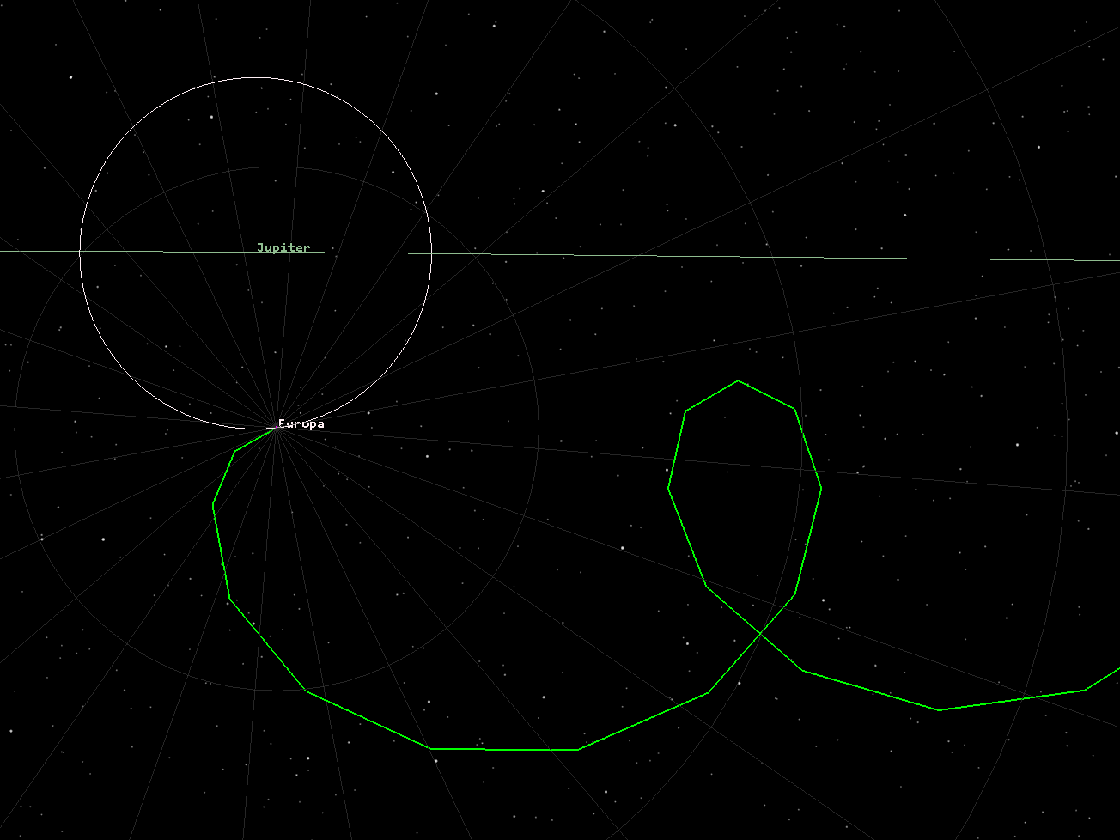
Europa Injection
Dec 8 203- 2.93 years from gravity assist
We plan to intercept Europa on the Sun side of Jupiter. At first this seems as if we are fighting the moons rotation but in figure 2, when in a Europa centric view, the crest of Talos’ arc is leading into the rotation.
Delta V injection: 6686.5 m/s
Talos will then perform a maneuver to position the orbit into a polar inclination
Delta V orientation: 156.84 m/s

Slide 11
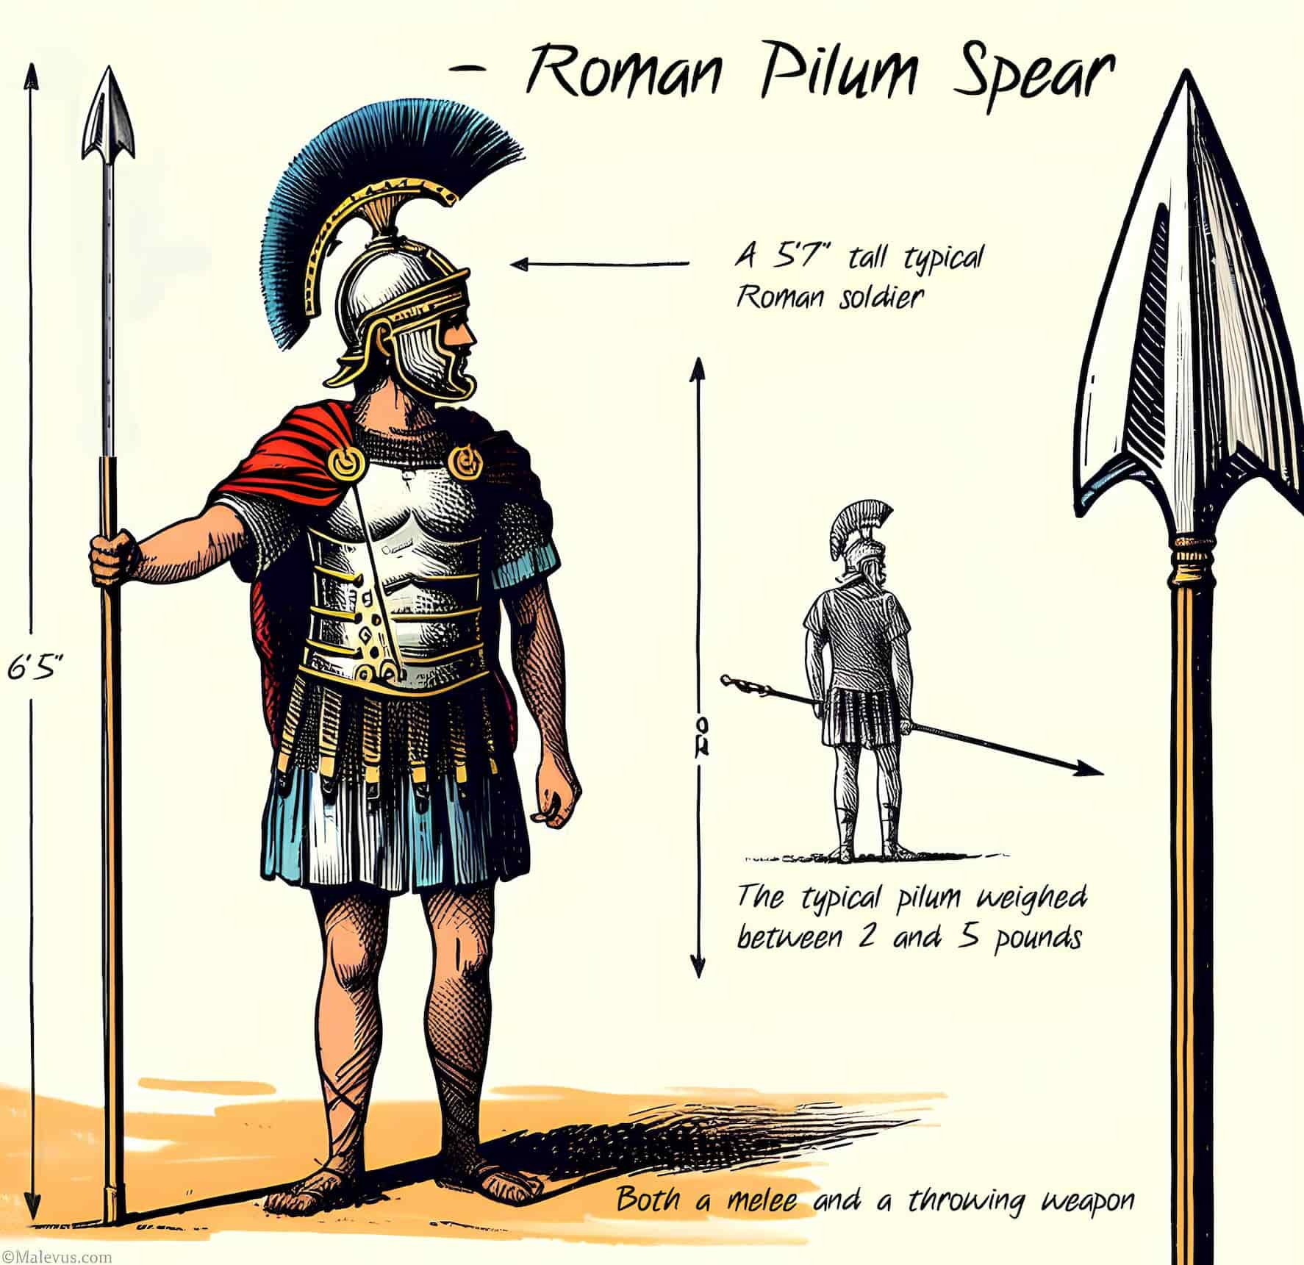
Deploying “Pilum”
Pilum will initially be used in intercepting a ice crystal particulate cloud ejected from the surface of Europa.
At a orbital radius of 1.05 radii above Europa, or an altitude of 78 km, Talos will deploy the pilum into a very gradual descent
Delta V Pilum: 17.16 m/s retrograde
The Pilum structural shell will break the fall on landing.
This maneuver will be completed by Talos by putting itself into a collision course, releasing Pilum, then raising its periapsis back to circular this will cost an additional:
Delta V Orbit Recovery: 20 m/s prograde

Slide 12
Systems

Slide 13
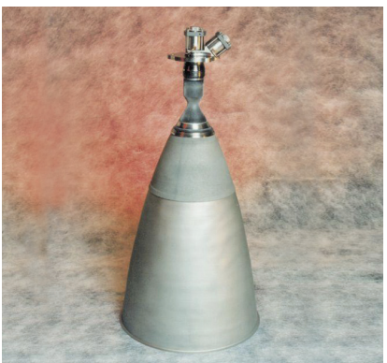
Propulsion- Control Thrusters
R-4D-11 Engine (Aerojet Rocketdyne) (2)
Bi-Propellant: 378-511N Thrust
Fuel: Monomethylhydrazine
Oxidizer: Nitrogen Tetroxide
~4kg each nose cone
Used for inclination maneuvers once in Europa’s orbit, and small Hohmann transfers to drop Pilum.
Second thruster for redundancy.

Slide 14
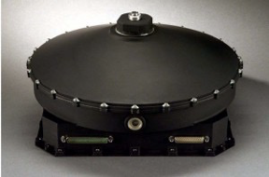
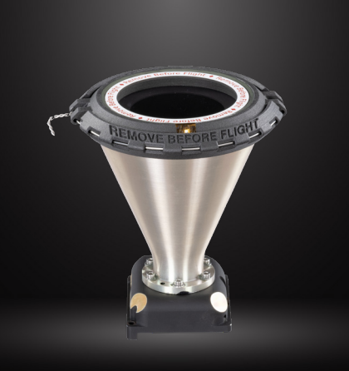
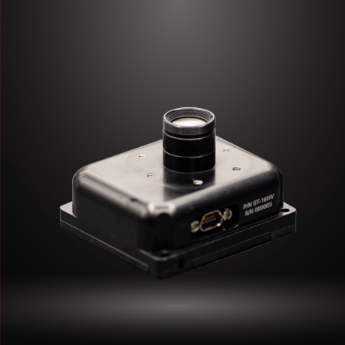
Guidance, Control, and Navigation
Reaction Wheels (4)
HR16 by Honeywell
Momentum Storage: 100 Nms
Mass : 12kg each
Power: 105W Max (<22W in Steady State)
Star Tracker & Attitude Tracker (2 each)
ST-16RT2 by Rocket Lab
Guides us to Europa/makes sure our attitude is correct.
Mass: 235 grams x 2(need two for redundancy)
Power: 1W x 2 of power
ST-16HV by Rocket Lab uses data from tracker to determine attitude
Mass: 148 grams x 2 (need two for redundancy)
Power: 1W x 2 of power per

Slide 15
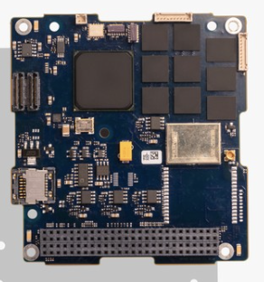
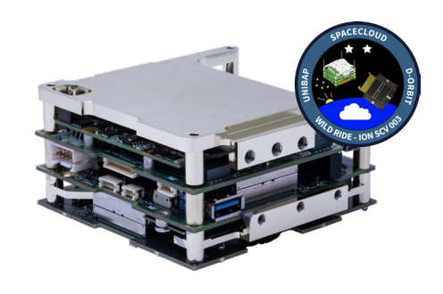
On-Board Processing
SpaceCloud® iX5-106 (Talos)
Weight: 4.5kgs
Power Consumption: 10-30W depending on usage.
Storage: 2 x 120 GB SATA SSD.
Used for On Board Processing along with data storage and communication.
Will handle all communication between devices and computing power for the devices on board.
Kryten-M3 (Pilum)
Weight: 61.69 grams
Power Consumption: 400 mW - 1W max
Storage: 4 GB
All Are Radiation Hardened/Resistant

Slide 16
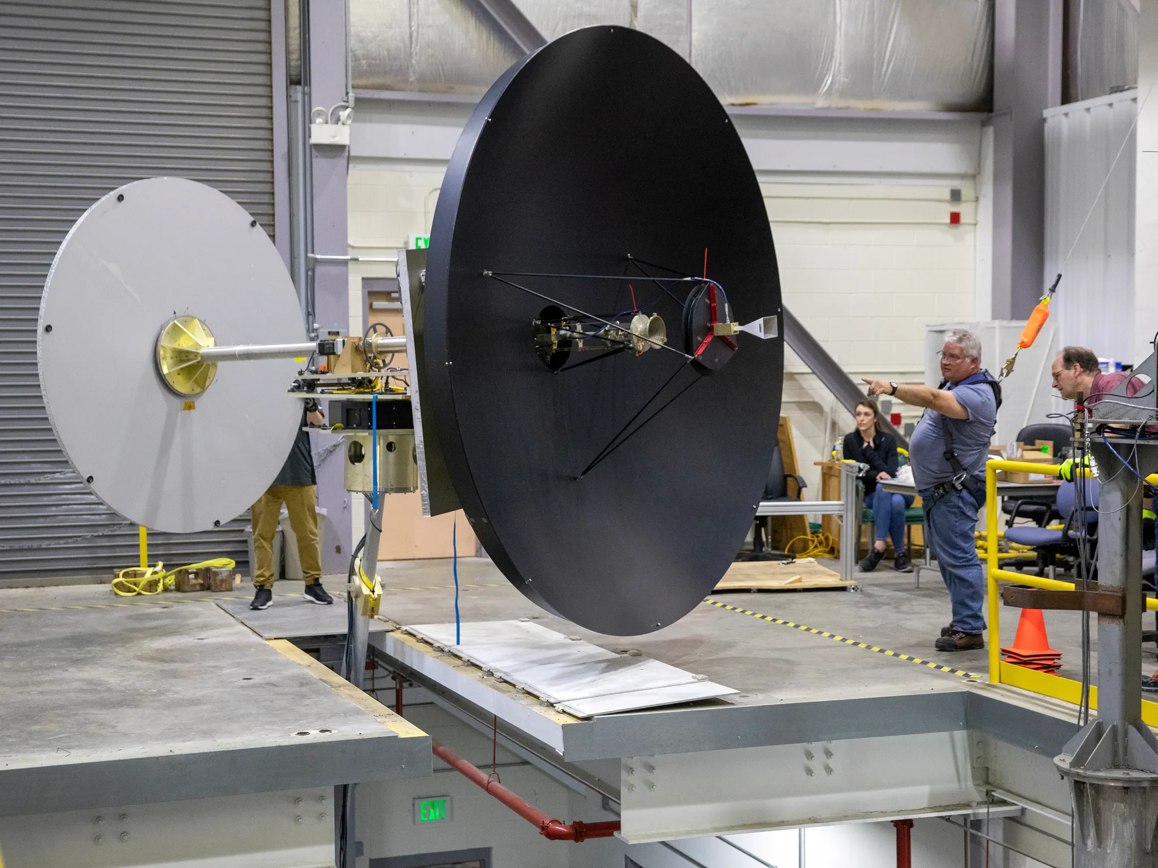
Telemetry, Tracking, & Communication
The satellite will use a X band radio frequency of 8.4 GHz and a Ka band radio frequency of 32 GHz.
Probe will use UHF band radio frequency of 3 GHz.
Frequency Band Selection approved by The National Telecommunications and Information Administration (NTIA).
The modulation technique for both the uplink and downlink will use Quadrature Phase-Shift Keying (QPSK) to support high data rates, the best power efficiency possible, and relatively narrow main lobe width
A 3m diameter High gain to High gain antenna for satellite
Low and high gain antennas on probe.
Peak Operating Power High Gain Antenna: 30 W
Mass of High Gain Antenna: 120 kg
Peak Operating Power Low Gain Antenna: 15 W (2, one for Pilum)
Mass of Low Gain Antenna: 30 kg (2, one for Pilum)

Slide 17
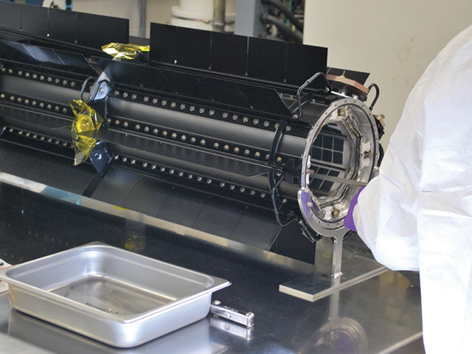
Power Generation and Storage
Talos:
Power Generation:
Triple Junction Gallium Arsenide Array (Ultra MJ)
Industry standard, high collection efficiency, and suitibible for areas of higher radiation, such as the space around Jupiter
Required Area:58.05 m^2
Power: +773.76 W (compensating for eclipse times)
Mass: 162.55 kg
GPHS-RTG (General-Purpose Heat Source- Radioisotope thermoelectric generator)
We will need 2 units
Each unit:
Power: +300 Watts
Mass: 57 kg
Volume: 0.422m Diameter x 1.14 m Long
Lifetime: 14 years
Power Storage:
Lithium Ion Batteries
Extremely efficient, very little loss
Must store ~575 Watts while sun exposed
Mass: 4.59 kg
Talos Power Total:
Power: 800 W average
Mass: 281.14 kg
Pilum:
Power Generation
MM(Multi Mission)-RTG
Power: +125 W
Mass: 45 kg
Volume: 0.64 m Diameter x 0.66 m tall
Power Storage
Lithium Ion Batteries
Mass: 1kg
Redundant power storage

Slide 18
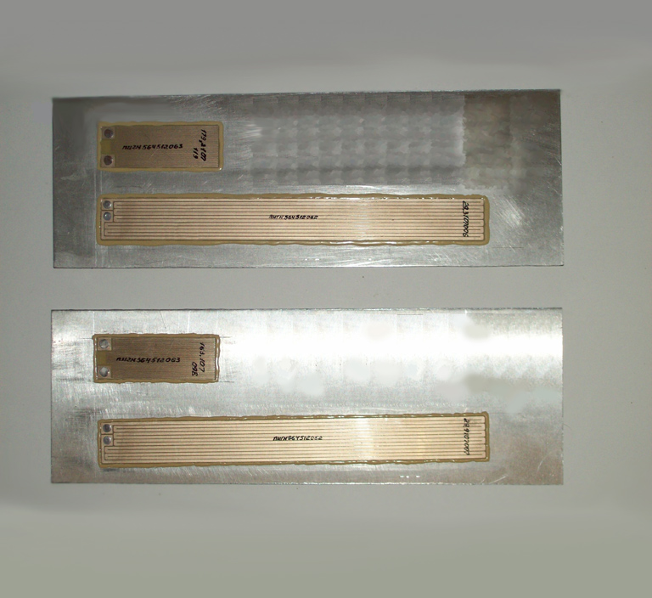
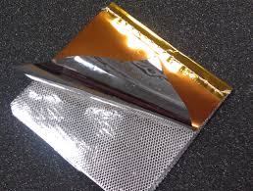
Thermal Regulation
Insulation: Space Grade Mylar Sheets
Area = 5 m x 1.2 m
Weight = 1 kg
Composed of aluminized Mylar and glass fabric
Can insulate temperatures between -250°F and 250°F
Heater: designed to maintain the surface temperature of the manned spacecraft body and the fastening elements of devices and assemblies within a given temperature range (3 units)
Weight = 0.055 kg each
0.165 kg total
Power = 5.897 W each
17.691 W total

Slide 19
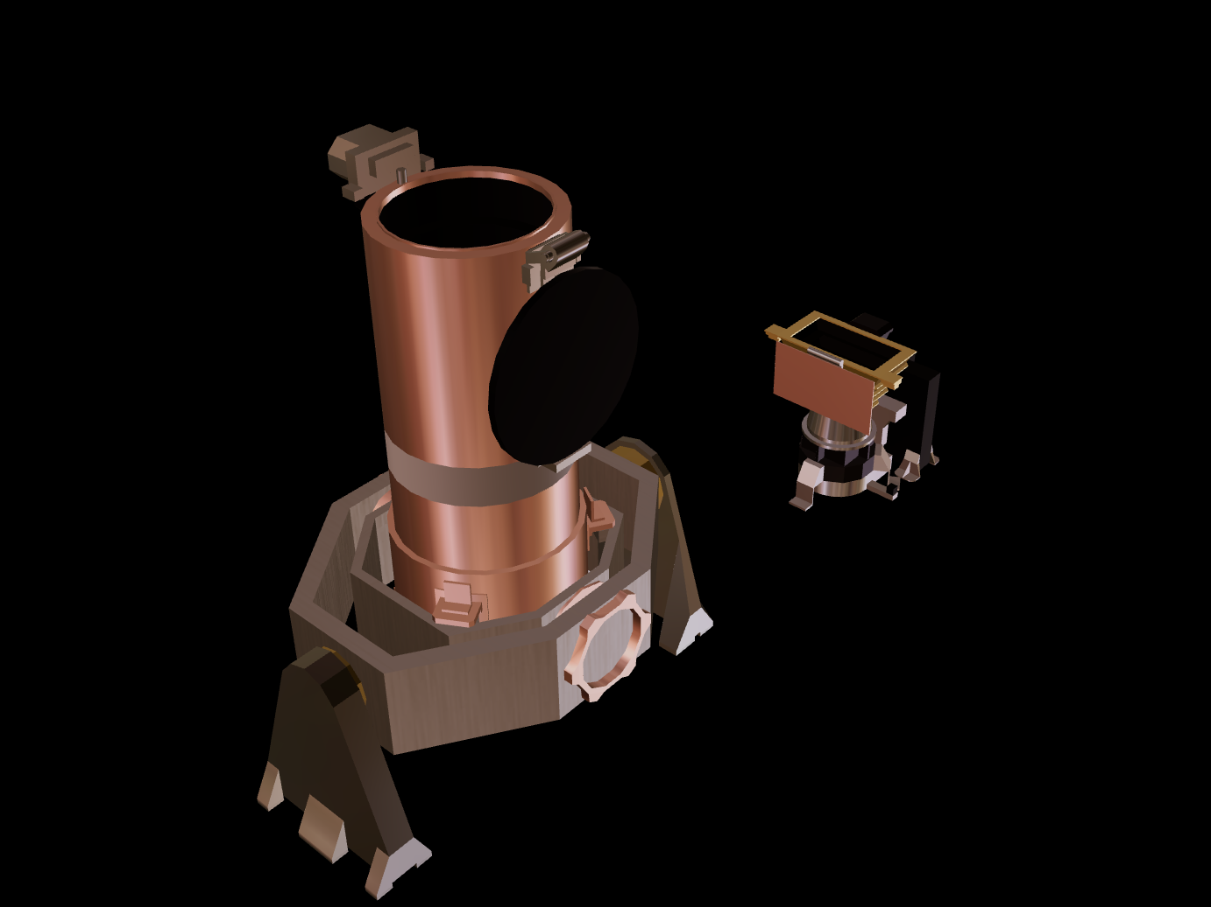
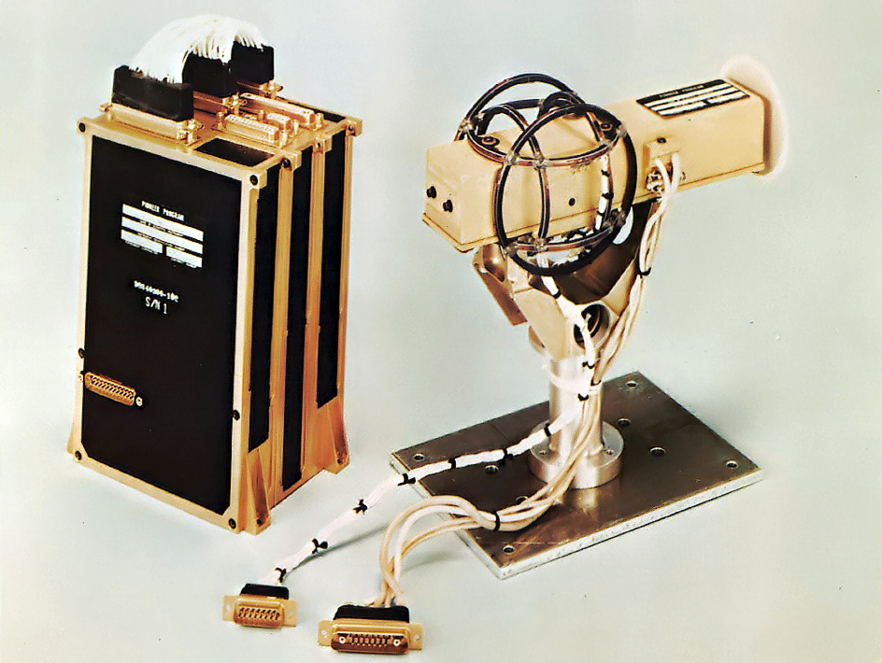
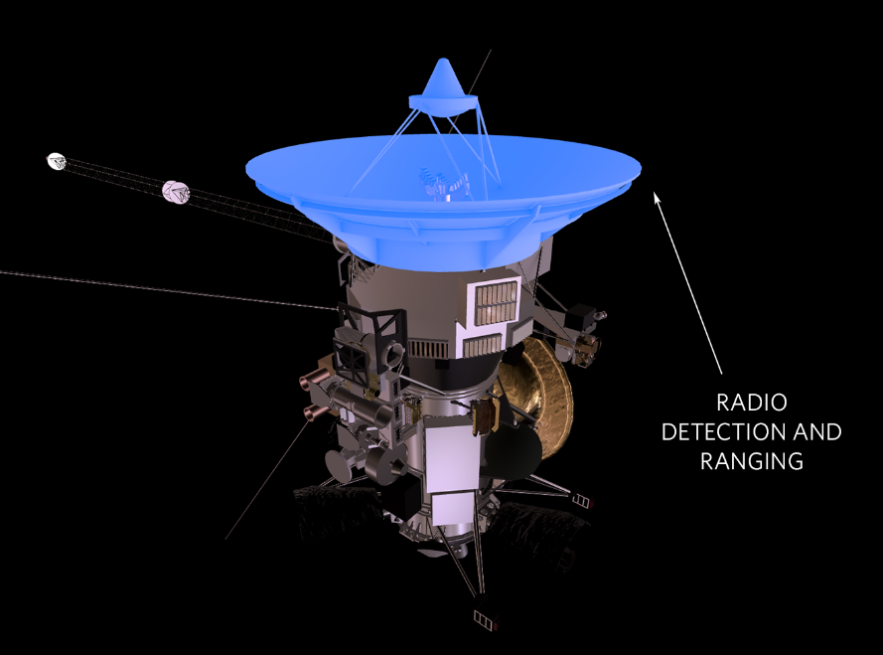
Science Instrumentation
Talos:
Multispectral Imaging System
Wide angle camera and narrow angle camera detecting visible light and some small infrared and ultraviolet wavelengths.
Mass: 58 kg
Peak Operating Power: 22 W
Peak Data Rate: ~365 kilobits/sec
Size: 95x40x33 cm (NAC) 55x35x33 cm (WAC)
Synthetic Aperture Radar System
Radio waves to map the topography of Europa
Altimeter and Radiometer
Mass: 45 kg
Peak Operating Power: 109 W
Peak Data Rate: ~364.8 365 kilobits/sec
Size: 16 m- retractable
3 Sensor Magnetometer
Reads in magnetic field information from nearby bodies
Mass: 31 kg
Power: 16.2 W
Data Bit Rate: 3.60 kilobits/sec
Size: 8 meter collapsable boom
Plasma Instrumentation Systems
Magnetic field near Europa carries charged particles called plasma that distorts the magnetic field and its signal.
Mass: 12 kg
Peak Operating Power: 16.2 W
Size: 4 Faraday cups each 7 cm deep and 20 cm wide
Total Mass: 146 kg
Total Power: 163.4 W
Pilum
Mass Spectrometer
Analyzes and determines the content of gases exposed to it
Mass: 61.75 kg
Power: 97 W
Size: 0.268 x 0.250 x 0.171 m
Surface/Dust Sample Analyzer
Analyzes and identifies small, solid matter
Mass: 16.8 kg
Peak Operating Power: 20.4 W
Size: 0.268 x 0.250 x 0.171 m
Total Mass: 78.55 kg
Total Power: 117.4W

Slide 20
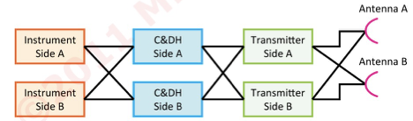
Electrical Structure
The structure we are going for is a block redundant and cross-strapped configuration.
Due to the duration length of the mission and the high amount of radiation coming from Jupiter, an electronics failure is more likely to happen.
This will double the amount of components and wiring but will greatly increase the success rate.

Slide 21
Spacecraft Design

Slide 22
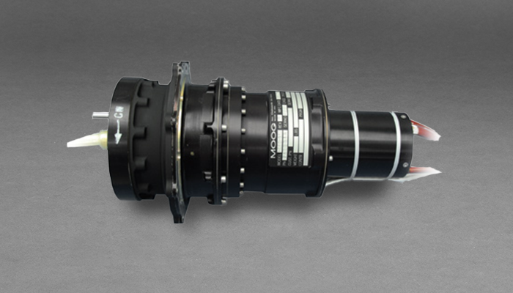
Structure & Mechanisms
Structure
We will use an aluminum 7075 frame because of its strength and anti-corrosion properties.
Density: 2.81 g/cm3.
Mass ~250-300 kg
Talos Mechanisms
Pilum Release Motor:
Power: 3 W
Mass: 1.6 kg
Solar Array System Gimbels (2):
Power: 3 W each
9.4 kg each
Pilum Drill: Specifically designed for this mission:
Low power usage: <100 W
Low mass: <10 kg
Long drill times
High torque

Slide 23
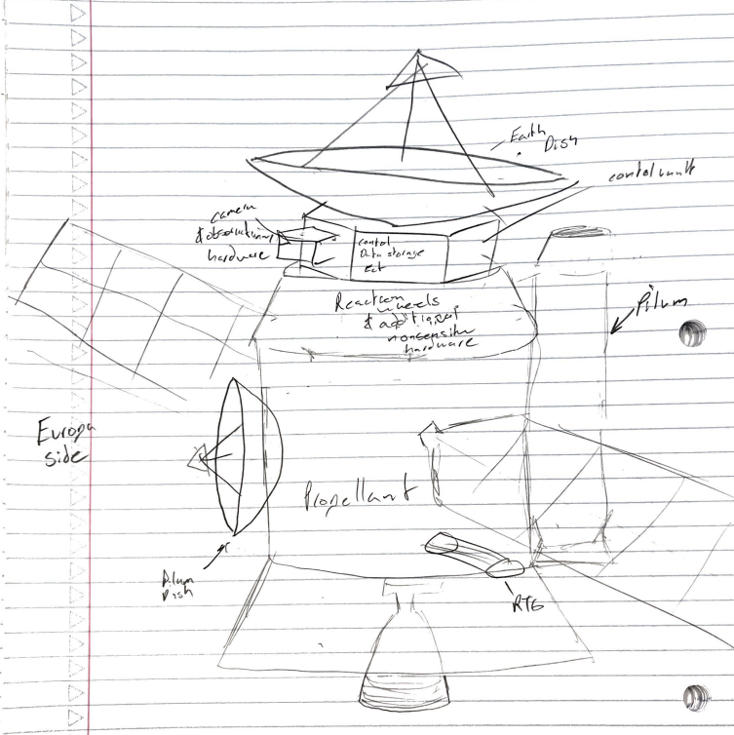
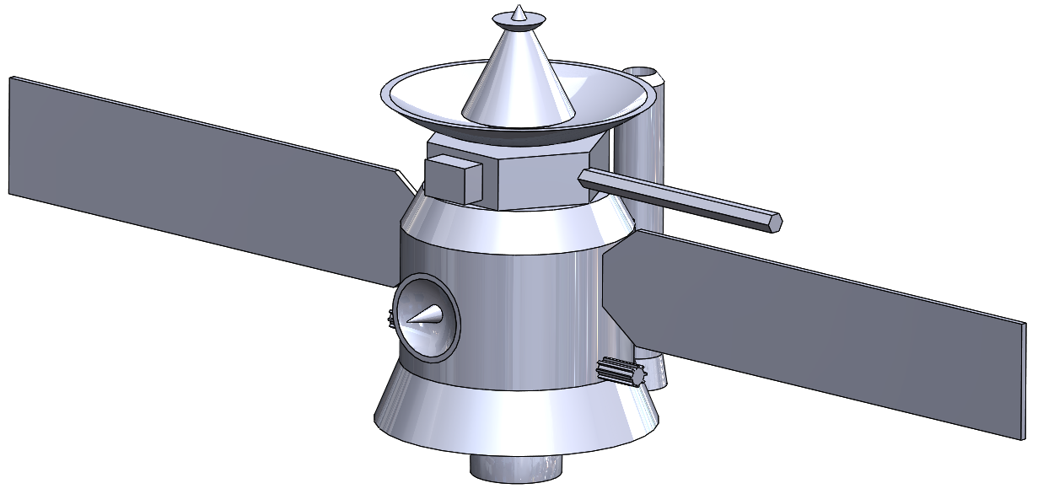
Preliminary Sketch & 3D Design

Slide 24
Mass and Power Budgets

Slide 25
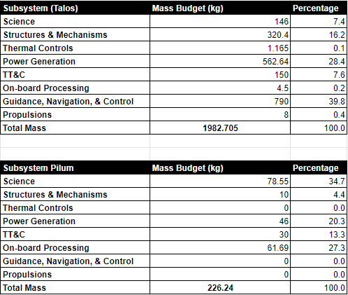
Mass Budget
Approximate mass of Pilum (Probe): 226.24 kg
Approximate dry mass of Talos (Satellite): 1982.705 kg
Estimated wet mass of Talos (including Pilum): 4417.89 kg
Notes:
According to NASA the approximate weight of the Europa Clipper to be launched in 2024 is around 13,000 lbs or 6,000 kgs.
Approximately half of this weight is dedicated to fuel.
Exact Numbers: Dry mass = 7,145 lbs (3,241 kg)
Launch mass = 13,371 lb (6,065 kg)
Payload mass = 776 lb (352 kg)

Slide 26
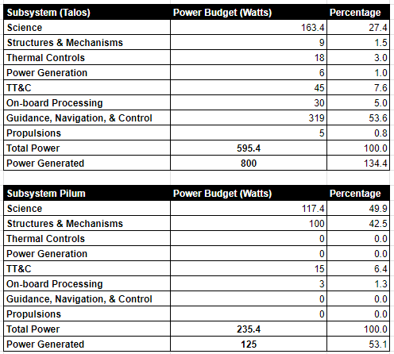
Power Budget
The power system for Talos is extremely variable based on what devices are currently in use. We calculated for the most extreme power usage plus ~35% extra for redundancy and a wider range of options when retiring the satellite.
For the Pilum, the RTG we equipped it with is already very heavy in comparison to the rest of the probe so we have to be very conservative on power usage. No two science or mechanism systems can run at the same time but if activated in order and separated in procedure, the data collection and transmission should be successful.

Slide 27
Moving Forward
Update and add detail to the model
Adjust course to reflect real world ability:
Consider a new launch date
Inject into Jupiter instead of Europa
Fly by Europa to scan for details
Potentially abandon probe since it would be undoable in this scenario
Explore new opportunities for science given this change
Add refinement to electrical structure setup
Consider utilizing launch vehicle differently due to our relatively low payload mass
Confirm volume limitations

Slide 28
Sources
https://science.nasa.gov/mission/cassini/spacecraft/cassini-orbiter/magnetometer/
https://pds-atmospheres.nmsu.edu/data_and_services/atmospheres_data/Cassini/inst-mag.html
https://en.wikipedia.org/wiki/Radar_for_Europa_Assessment_and_Sounding:_Ocean_to_Near-surface
https://en.wikipedia.org/wiki/Multi-mission_radioisotope_thermoelectric_generator
https://en.wikipedia.org/wiki/GPHS-RTG
https://europa.nasa.gov/mission-updates/41/10-things-to-know-about-europa-clippers-science-instruments/
https://meetingorganizer.copernicus.org/EPSC2014/EPSC2014-229.pdf&lang=en
https://europa.nasa.gov/internal_resources/379/ScienceInstruments_031422_Public.pdf
https://www.esa.int/Enabling_Support/Space_Engineering_Technology/Onboard_Computers_and_Data_Handling/Onboard_Computers#:~:text=The%20term%20%E2%80%9COn%20Board%20Computer,the%20On%20Board%20Software%20run.

